Slide 1
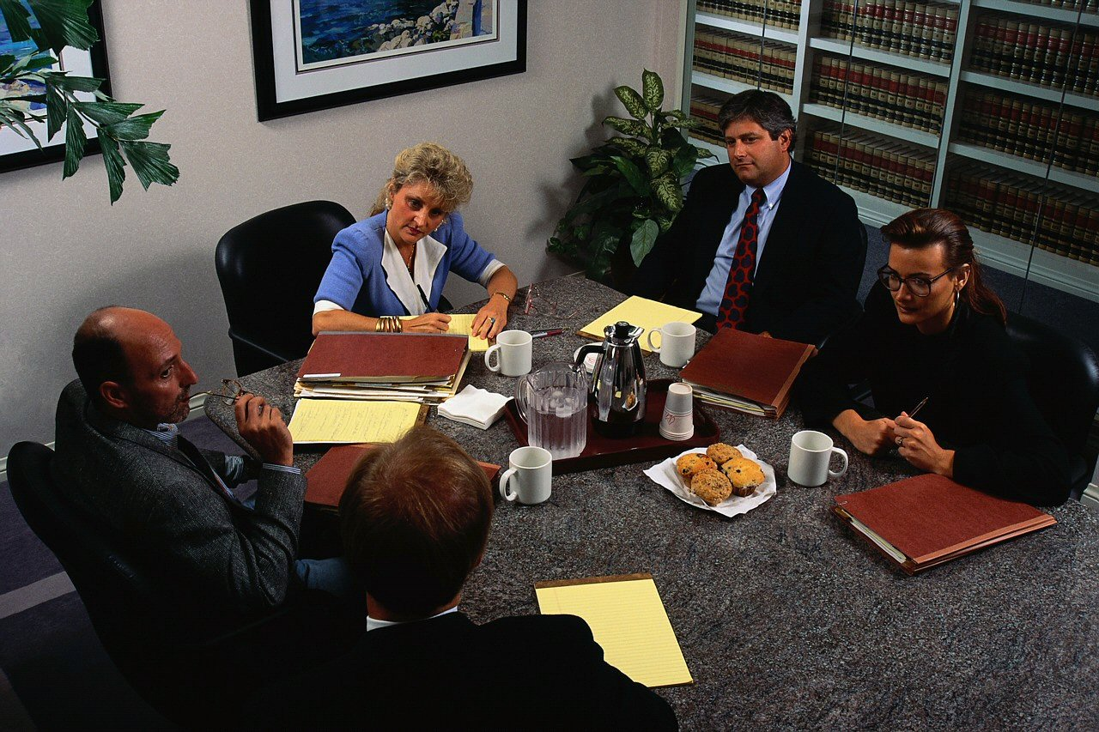
Informal Oral Communication
CHAPTER FOURTEEN

Slide 2
Informal Oral Communication Overview
Informal Talking
Conducting and Participating in Meetings
Telephone and Voice Mail Techniques
Dictating Messages and Reports
Listening
Nonverbal Communication

Slide 3
Elements of Good Talking
Voice Quality
Talking Style
Word Choice and Vocabulary
Central Role of Adaptation

Slide 4
Voice Quality
It is pitch and resonance of vocal sounds
Not all voices are good
How to improve yours:
  You know good voice quality.
  Listen to yourself.
  Do what you can to improve.

Slide 5
Talking Style
It is the blending of pitch, speed, and volume.
To improve
  Analyze your style. Listen to yourself.
  Then do what you can to make yours better.

Slide 6
Word Choice
Adapt. Choose words in your listener’s vocabulary.
Recall adaptation suggestions in chapters 2 and 3.

Slide 7
Adaptation
The preceding suggestion applied to the whole message.
It is more than just word choice. It also concerns idea simplification.

Slide 8
Courtesy in Talking
Don’t dominate or drown out others.
Apply the Golden Rule; accord others the courtesy you expect from them.

Slide 9
Techniques for
Conducting Meetings
Plan the meeting.
Follow the plan.
Move discussion along.
Control those who talk too much.
Encourage participation from those who talk too little.
Control time.
Summarize at appropriate places.

Slide 10
Techniques for
Participating in Meetings
Follow the agenda
Participate
Do not talk too much
Cooperate
Be courteous

Slide 11
Using the Telephone
Trivial? Perhaps.
But many of us have bad techniques.
  Bad voice quality – gruff, shrill, soft
  Inconsiderate (usually unintentional)

Slide 12
What you can do about it.
Listen to yourself – record a conversation.
Work for naturalness.
Follow recommended procedures for courtesy.

Slide 13
Techniques of Telephone Courtesy
When calling
  introduce yourself and ask for person you want
  explain purpose of call if unsure of person to contact
When answering
  identify company/office and offer to help
  emphasize thoughtful answering practices

Slide 14
Effective Voice Mail Techniques
Speak clearly and distinctly
Identify yourself by name and affiliation
Give overview of message
Continue with details
Ask for action if needed
Speak slowly with callback information
End with goodwill comment

Slide 15
Wireless Telephones
Now widely used.
And growing fast.
But they have created a nuisance.

Slide 16
We can reduce their annoyance by
Turning off ringer in meetings and other places where disruptive
Not using them at social gatherings
Not placing them on the table while eating
Avoiding talking with others are in earshot
Avoiding discussing personal matters around others
Not talking too loud
Calling from a quiet place
Being courteous to those around while talking
Avoiding use while driving

Slide 17
Techniques of Dictating
Gather the facts.
Plan the message.
Make the words flow.
Speak clearly.
Give paragraphing, punctuation, and other instructions as needed.
Play back intelligently.
Proofread for accuracy.

Slide 18
Listening
The receiving end of communication
Causes more problems than the sending end.
It involves
  sensing,
  filtering, and
  remembering.

Slide 19
To improve your listening
You must first want to improve.
Then work to pay attention.
Work on the accuracy of your filtering – think.
Work to remember – concentrate.

Slide 20
The Ten Commandments of Listening
Stop talking
Put talker at ease
Show talker you want to listen
Remove distractions
Empathize with talker
Be patient
Hold your temper
Go easy on argument and criticism
Ask questions
Stop talking

Slide 21
Nonverbal communication
It is the communication that occurs without words.
It accounts for a larger part of the message than words.
We use it to reinforce our words.
But it also communicates by itself.

Slide 22
Types of nonverbal communication: (1) Body language
How we gesture with arms, fingers, hands, face
How we stand, walk
Our posture at
Our eye movements
The clothes we wear and how we wear them
How we decorate our bodies (tattoos, piercing)
Etc.

Slide 23
Types of nonverbal communication: (2) Space
Intimate (contact to 18 inches)
Personal (18 inches to 4 feet)
Social (4 to 12 feet)
Public (12 feet to range of sight)
Our behavior in each is determined by our culture.
We need to be sensitive to the space conditioning of others.

Slide 24
Types of nonverbal communication: (3) Time
Concepts of time also vary by culture.
Punctuality, orderly activities vary in importance by culture.

Slide 25
Types of nonverbal communication: (4) Paralanguage
It is how the words are delivered.
It is the speed, pitch, emphasis, volume, and such that we give the words.
Recall the text example: “I am a good communicator.”
  Repeat five times emphasizing a different word each time.

Slide 26
“If speaking is silver,
then listening is gold.”
--Turkish Proverb

